Slide 1
CSE718
Nishat Nayla
23366022

Slide 2
Modeling and Simulation of Complex Electromechanical System of More-Electric Aircraft Based on Distributed Simulation Technology

Slide 3
Introduction

Slide 4
Objective: Address the challenges in simulating complex electromechanical systems in more-electric aircraft.
Importance of Simulation: Essential for system design and development in modern engineering, especially in aircraft systems.
Focus Areas: Accuracy of the simulation model, adaptability of the simulation environment, computational power.

Slide 5
Methodology

Slide 6
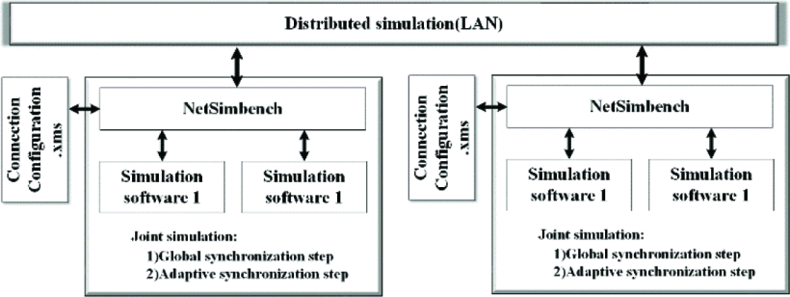

Slide 7
Distributed Simulation Techniques
Complexity: Multi-domain, multi-disciplinary, and multi-coupled system.
Approach: Hierarchical engineering modeling, functional, logical, and physical architecture.
Software Integration: Utilization of Saber, Matlab, AMESim, and Simplorer for a heterogeneous joint simulation environment.

Slide 8
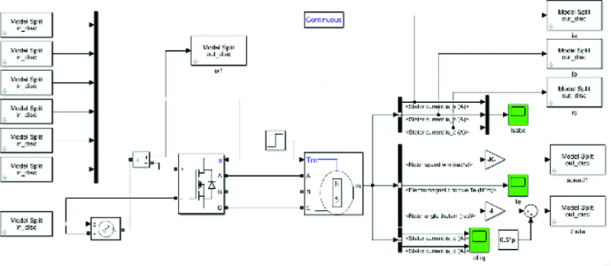

Slide 9
Simulation Platform Design

Slide 10
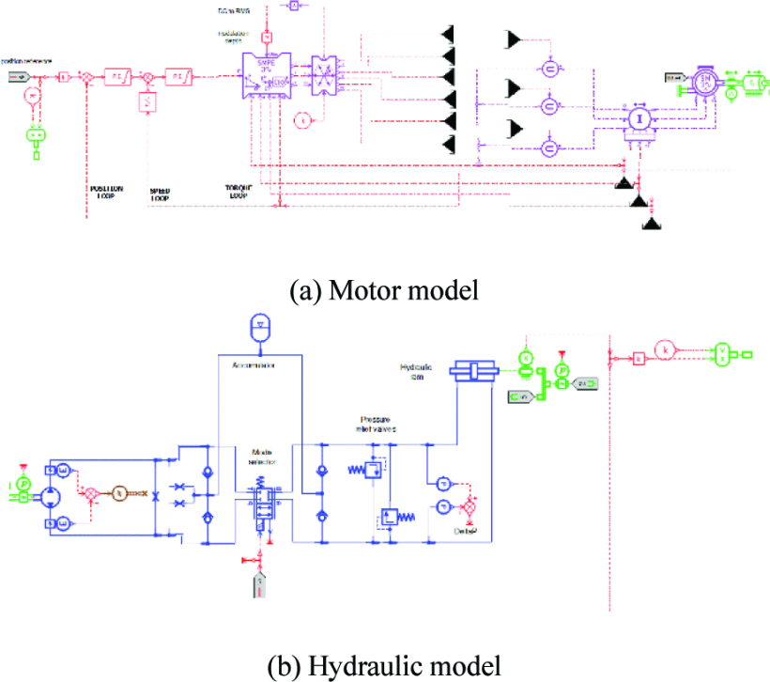

Slide 11
System Composition: Electrical control system, power distribution system, energy storage system, power converter, various types of loads.
Modeling Details: Simulation of complex components like DSP chips, load management, and electric drive model control.
Software Implementation: Embedded processor control models in Saber, motor models in Matlab, hydraulic models in AMESim.

Slide 12
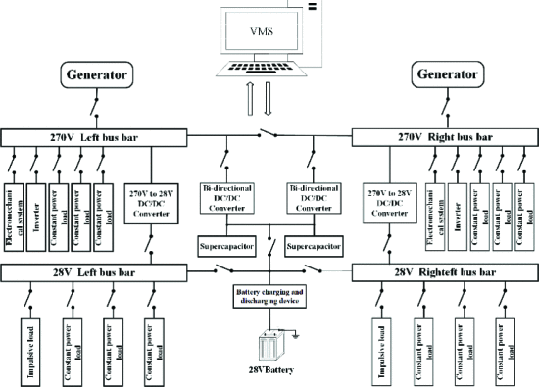

Slide 13
Simulation Results Analysis

Slide 14
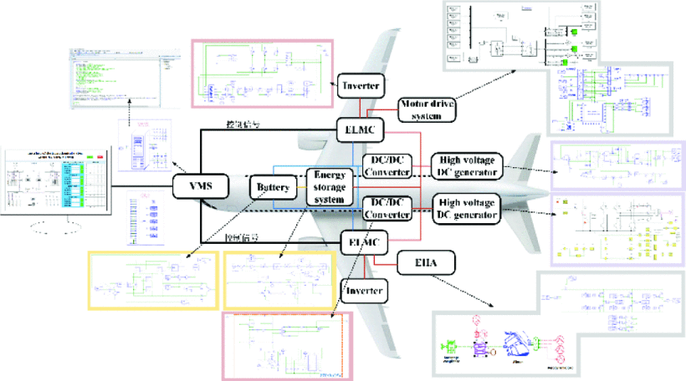

Slide 15
Setup: High-performance workstations and high-speed switch.
Performance: Stability of the DC power supply system, reliability of generators and converters, functionality of loads.
Visualization: Display of simulation waveforms and data interaction.

Slide 16
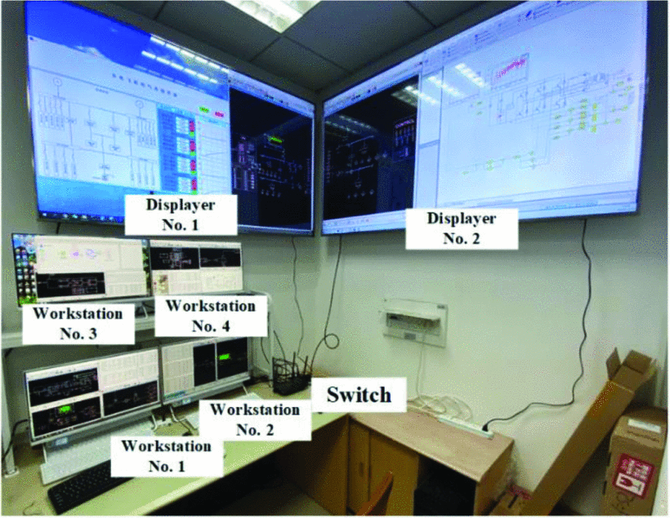

Slide 17
Conclusion
Achievements: Effective distributed simulation platform integrating multidisciplinary, multi-level, and multidimensional models.
Advantages: Strong scalability, operability, reduced convergence difficulty.
Impact: Assists in the development and verification of electromechanical systems in more-electric aircraft.

